Slide 1



For Loops
A guide in Python
Notes:
Welcome back! In this video, we will be discussing for loops, but what are for loops?
Well, for loops are programming constructs that are used to iterate over a sequence executing a block of code for each item in that sequence until a condition is met.

Slide 2


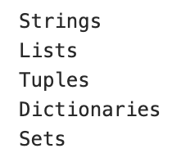
Sequences
Notes:
Sequences include strings, lists, tuples, dictionaries, and sets.

Slide 3

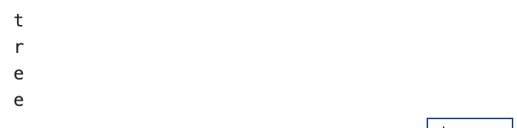
Looping through a String
Notes:
Strings are considered iterable objects because they contain a sequence of characters.
A for loop is written by using the keyword for, followed by the word in, followed by a sequence (in this case, the string ‘tree’), followed by a colon, followed by an indented block of code (in this example, the print statement) to execute the function for each item within the string.
Here, the for loop will return t, r, e, e. Now, let’s take a look at what would happen if we looped through a list.

Slide 4
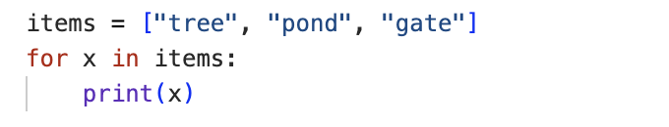
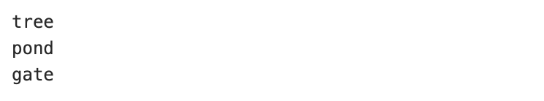
Looping through a List
Notes:
In this example, we first initialize a list of objects in square brackets, with each item separated by a comma, assigning the list to the variable items, to which we then apply a for loop to iterate through the list and print each item. Here, the output 'tree', 'pond', 'gate' is returned.

Slide 5
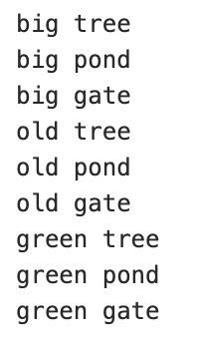
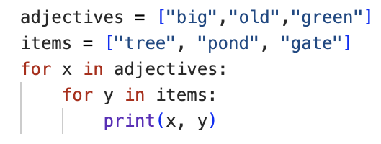
Nested Loops
Notes:
For loops can also be placed inside for loops, and these are called nested loops. These can be particularly useful when working with multi-dimensional data. In nested loops, the inner loop (in this case, items) will be executed one time for each iteration of the outer loop (in this case, adjectives). Here, this means that for each adjective printed, each item is printed alongside it, producing the output shown here of big tree, big pond, big gate, old tree, old pond, old gate, green tree, green pond, and finally green gate.

Slide 6


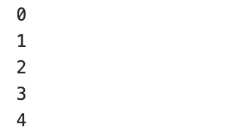
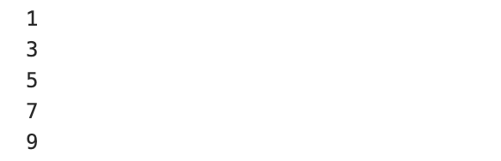
Using range()
Notes:
Now, if we want to loop through a set of code a specified number of times, we can use the range function.
The range function returns a sequence of numbers based on three parameters: the starting number (zero by default), the ending number, and the increment (one by default).
In the first example, we see that we can assign just the ending number (in this case, five), which specifies that the for loop iterates through and prints a range of five values from zero to four.
In the second example, we specify that the for loop iterate through a range of ten values, starting at one, and printing in increments of two, outputting one, three, five, seven, and nine.

Slide 7
Challenge Yourself
Write a for loop that outputs the statement ‘number {} is divisible by 3’ if the product of 2 numbers (i and j) both in the range 1 to 4 is divisible by 3.
Print the output of this statement.
Notes:
And that’s this lesson on for loops complete. Now we would like to give you the opportunity to challenge yourself by trying the assignment set on this slide.
Answers will be discussed in the following slide, so make sure to pause this video now while you work through the task.

Slide 8
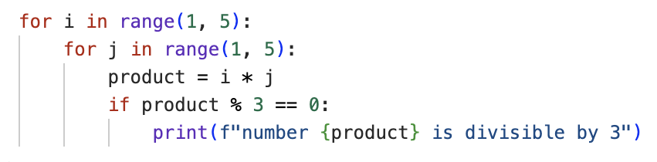

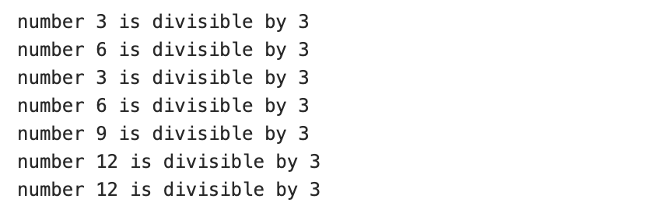
Notes:
We asked you to try writing a for loop that outputs the statement ‘number {} is divisible by three’ if the product of two numbers (i and j) both in the range 1 to 4 is divisible by three, so our code uses the range function and a nested for loop containing an if statement. The output of this code is as shown here.
How did you find this? If you got it right, congratulations! If not, that’s okay. We don’t always get things right on the first try. There’s still plenty of time to learn, and the teaching staff will be happy to work through any problems with you. Just give us a shout!
Otherwise, see you in the next video.

